Slide 1


Used Car Price Prediction Project
Khushboo Khatri

Slide 2
INTRODUCTION: Our entire project consist of two parts.
Data Collection
We scrape the data from car24.com website. We scrape all used car data from Delhi Loaction
Model Building
We Perform Model Building Operation on the data collected , which is in the form of excel file.

Slide 3
Data Collection
We use Selenium to scrape the data from the website car24.com.
Our Objective was to scrape all the details of the listed cars from Delhi region. We got details of 5660 used cars.
The details are scraped and store into different variables and we compile them in order to make a dataframe.
Once we create our DataFrame we convert it into excel file by using .to_excel () and save it.

Slide 4
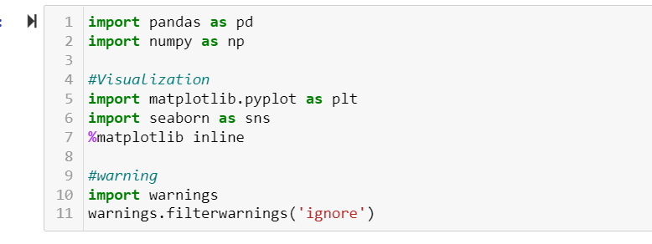
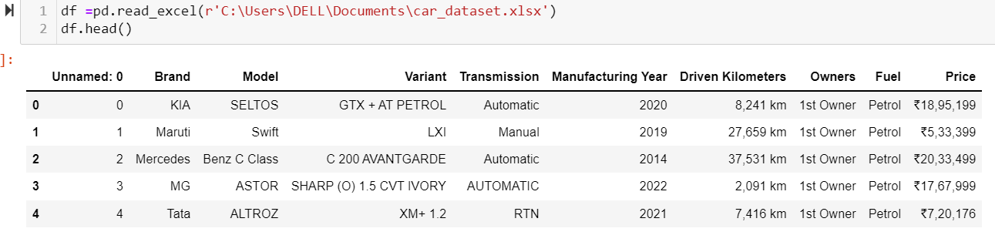
Model Building
Once we collect and save the data, we use it in order to build our used car price prediction machine learning model.
We start with getting the data: for that we need to import all the necessary libraries. Then we get the data using .read_excel().

Slide 5
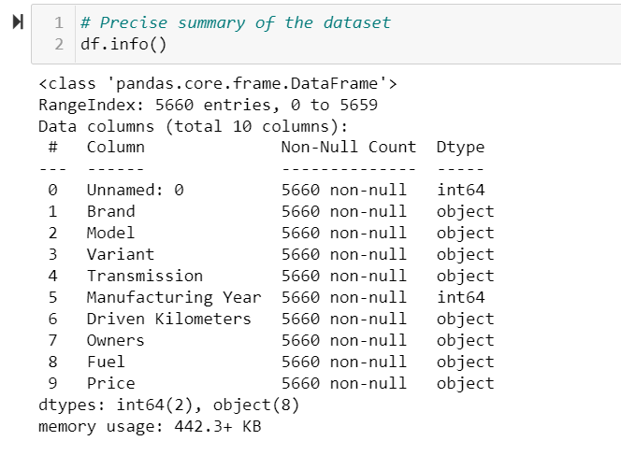
Let’s look at the precise summary of dataset , for that we use .info()
From here we can Observe that our dataset consists of 10 columns, out of which column Unnamed: 0 is indexing columns, which will be of no use in our machine learning model building purpose. So, we can drop it.
We don’t have any missing value or Null values in our dataset, means we don’t need to perform any imputation.
We can observe that , in our dataset we don’t have any null values. The total number of rows are 5660 & columns are 10. Except Unnamed: 0 and Manufacturing Year all other columns are of object type, these two are of integer type columns.
Price and Driven Kilometers are two columns which has informative numerical values which we need to fetch as it is removing the km from Driven Kilometers column and ₹ from Price column.
For remaining columns, we need to do some kind of encoding or mapping to fit them in the machine learning model.

Slide 6
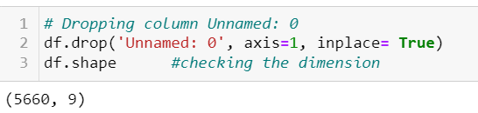
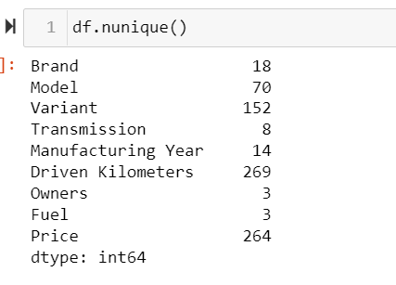
Dropping unwanted column: Dropping any column is part of Data Cleaning, Let’s go ahead and see how many unique value is contained by each column. We can see that our nominal data has high number of cardinality, so to encode them we can use either label encoder or Binary encoder. As one hot encoder increases the number of columns to a very great extend and hence affects the efficiency and time consumed and over all cost of production.

Slide 7
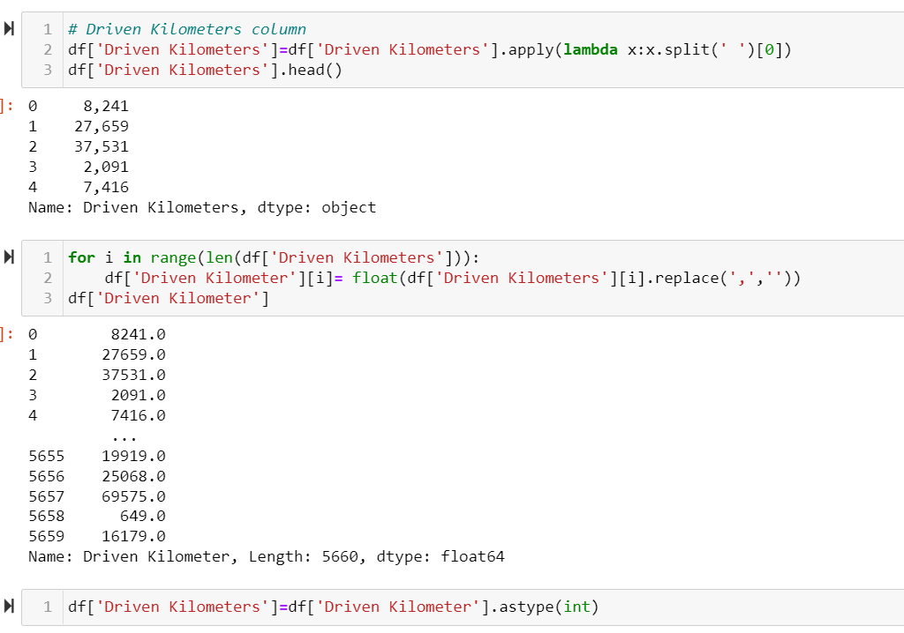
Feature Engineering and EDA
Feature engineering is a machine learning technique that leverages data to create new variables that aren't in the training set, with the goal of simplifying and speeding up data transformations while also enhancing model accuracy.
In our dataset we have some columns from which we need to extract meaningful data. Let’s start with Driven Kilometers, its an object type column need to convert in numerical column with loosing any important information.

Slide 8
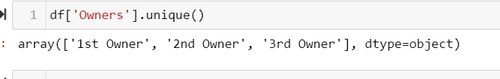
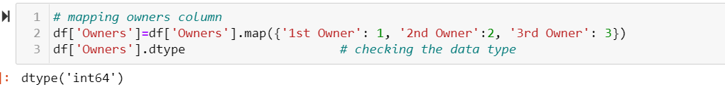
Owners column, it also object type of data where we need to derive important information without losing the credibility of data.
We can see that data is in descriptive form, we will map it to direct 1, 2, 3.
Now our owners column is defining in numerical form, with credible information.

Slide 9
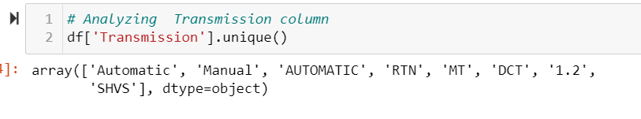
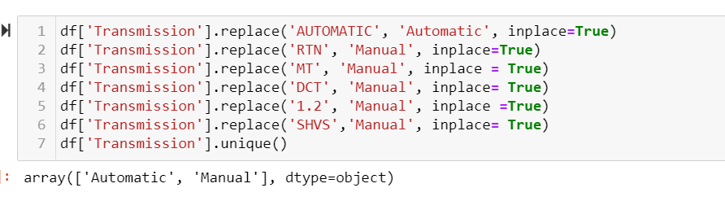
Transmission Column: Basically we have two types of transmission in cars, Manual and Automatic. So here we need to fit them all into this genuine option.
Now in our dataset, we got valid option for transmission.

Slide 10
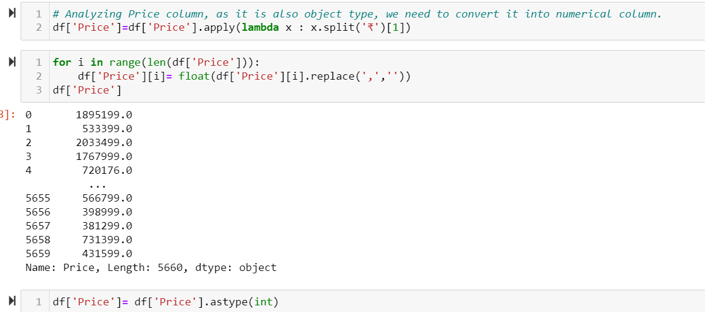
Price column: This column also has valuable numerical information but is in object form, We need to convert this column to numerical column without losing any valuable information.
Now our Price column is successfully converted into numerical type without loosing any information.

Slide 11
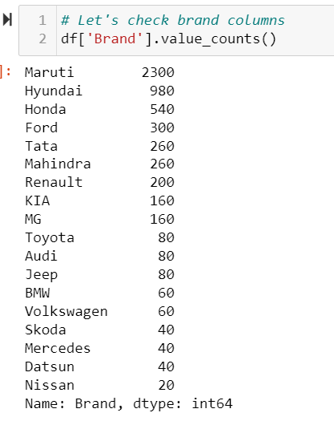
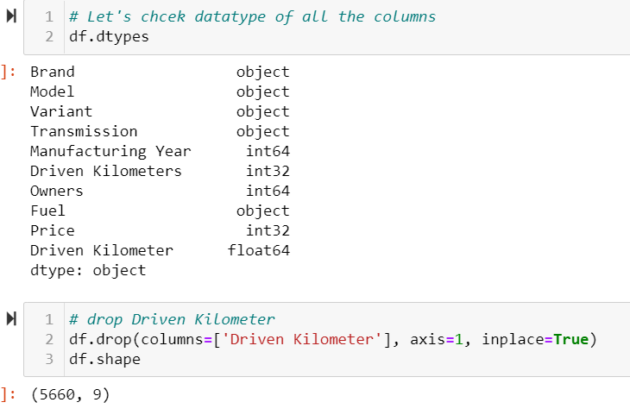
Let’s check for Brand Column if it has any duplicates. Also we need to check the datatype of the dataset once again.
Here we drop Driven Kilometer as it repeat itself.

Slide 12
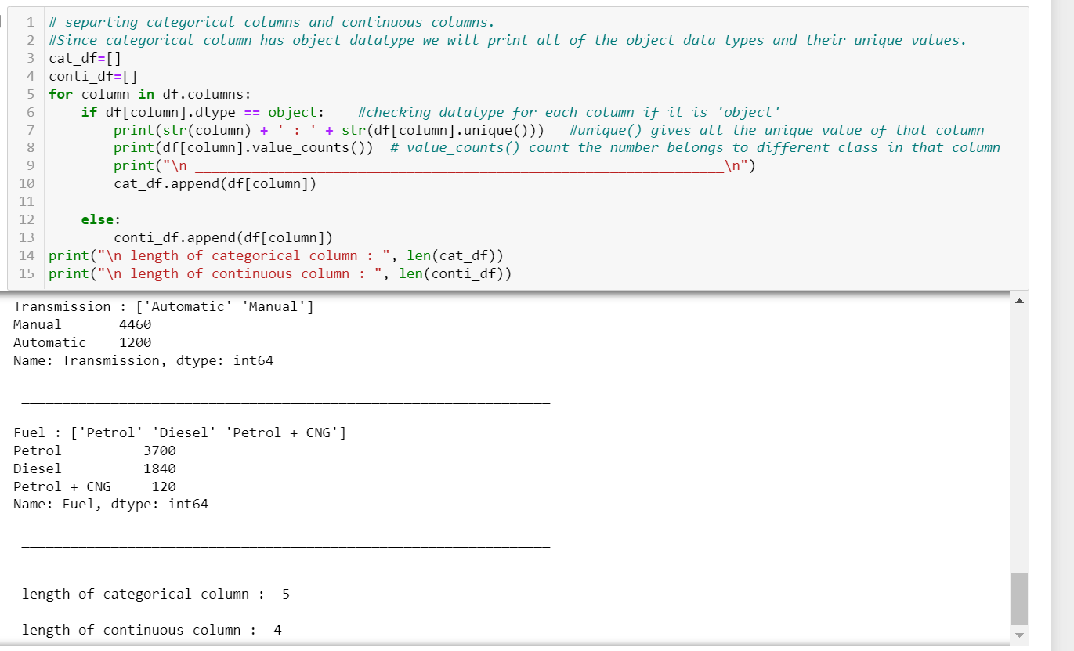
Separating categorical and continuous column

Slide 13
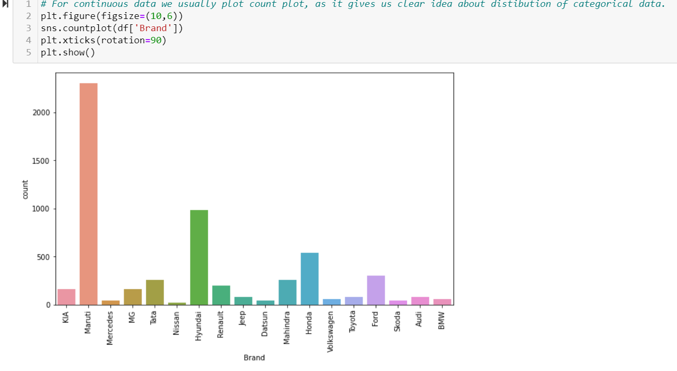
Univariate Analysis:
We can observe that Brand Maruti has the highest record for cars while Nissan has lowest.

Slide 14
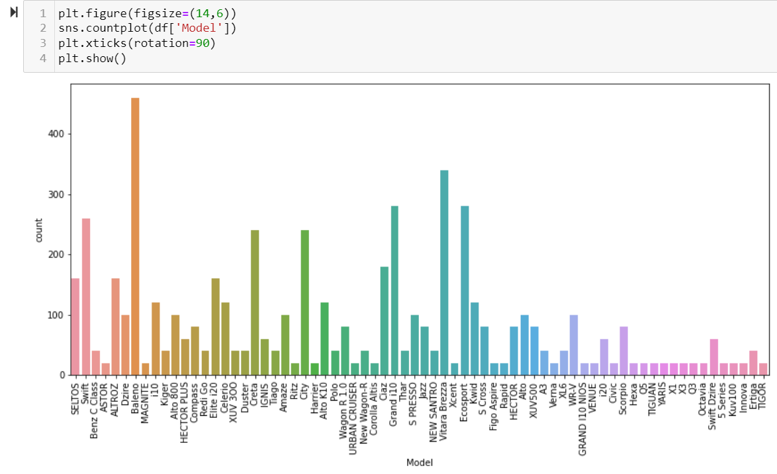
From above observation we can clearly see how Models of various cars present in the marketplace in order to sell.

Slide 15
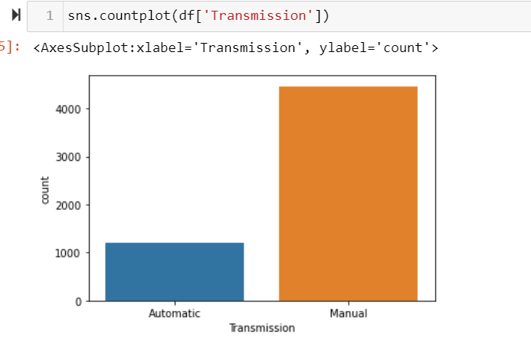
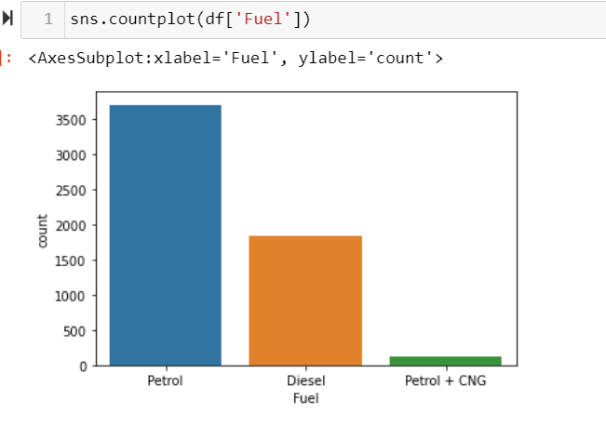
There are a greater number of manual cars ten automatic cars available in Indian market.
We can observe that more number of Petrol cars are in the market. Even there are few cars which run on Petrol + CNG. I am assuming they would be cabs, as cabs in Delhi mostly runs on Petrol + CNG.

Slide 16
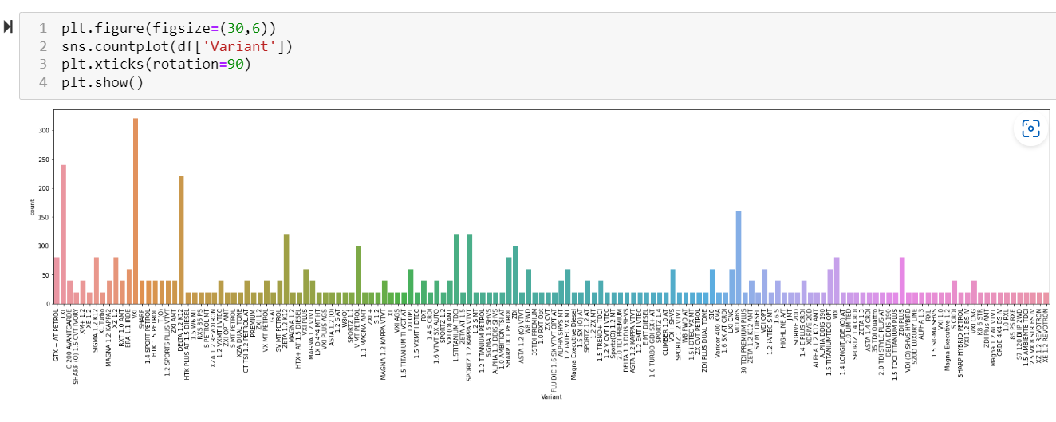
We can observe that, there are some variant which are high on the market like VXI model followed by LXI than other variant of car.

Slide 17
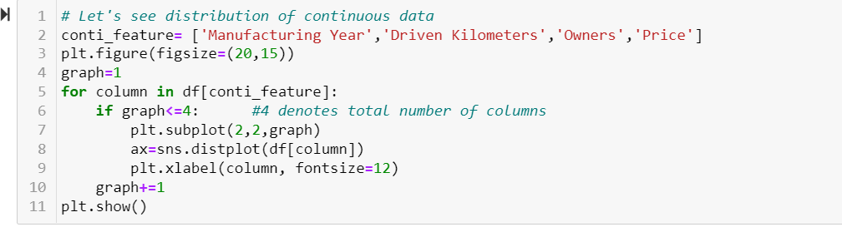
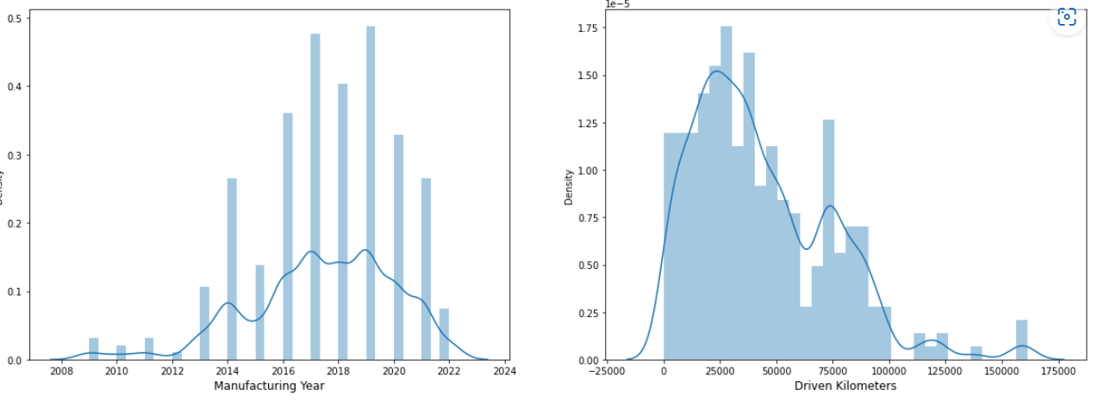
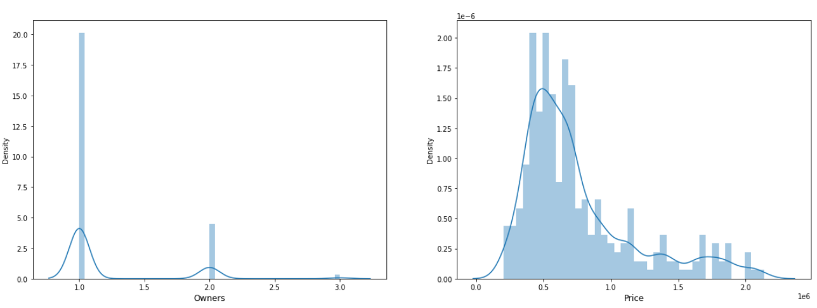
Visualization of Continuous data Distribution.

Slide 18
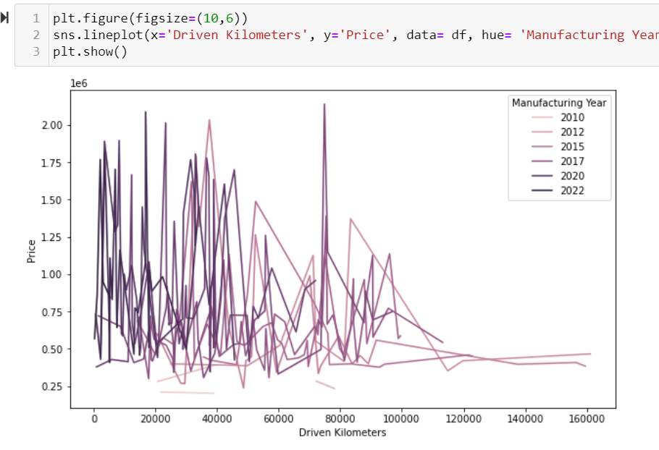
Multivariate Analysis
We can observe that as the car gets older the Price decreases. Also, the Price also depends on Brand and other features also, that is the reason we can see both high and low even for newer cars.

Slide 19
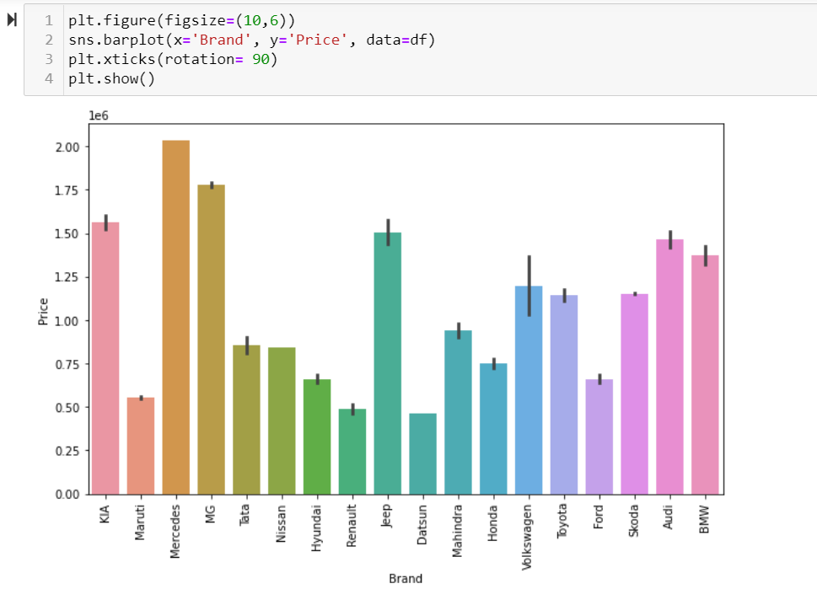
We can observe that Mercedes, MG are comparatively expensive Brands in car, while Datsun, Maruti are cheaper than rest.

Slide 20
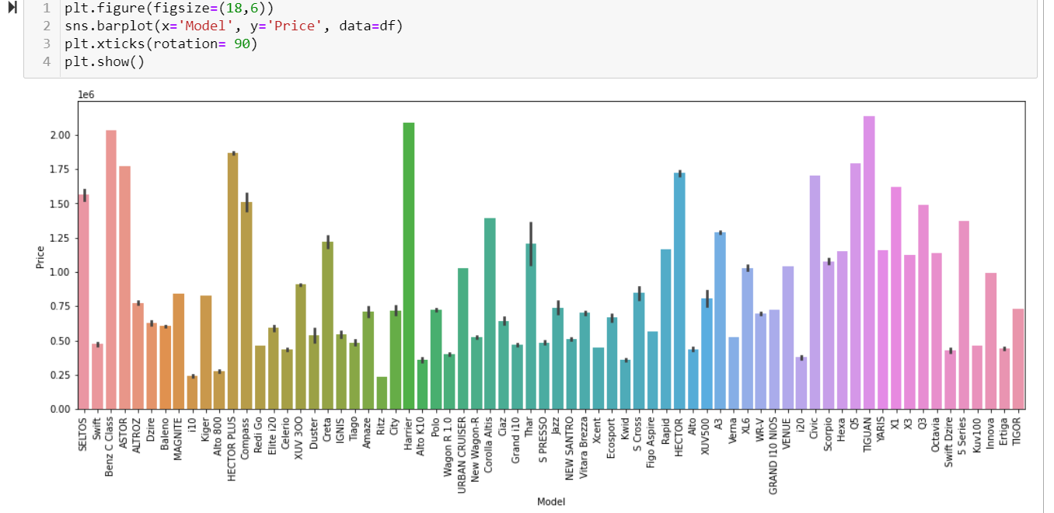
We can observe that Tiguan, Harrier are the expensive cars followed by Benz C class, while Ritz, i10 , auto 800 are compact under lower budget vehicles.

Slide 21
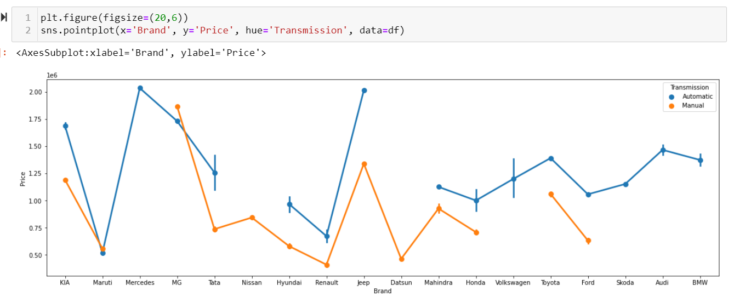
We can observe that automatic vehicles are comparatively expensive then manual transmission

Slide 22
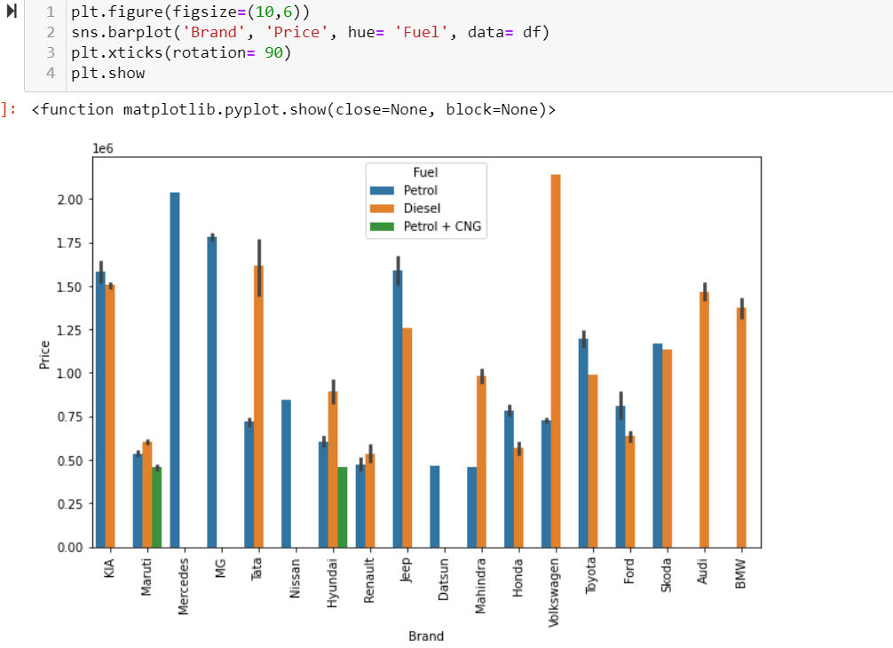
Maruti and Hyundai are the Brands which has all three types of fuel engine. Audi and BMW has Diesel cars only while Mercedes, MG, Nissan, Datsun Brands has Petrol cars only in our dataset.

Slide 23
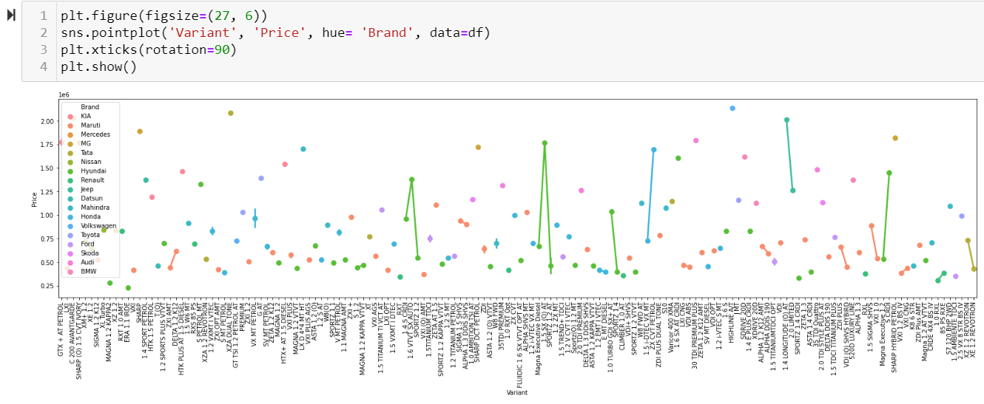
From here we can observe that variant plays an important role in determining the price of car. Brands themselves consist of certain variant in cars which are expensive.

Slide 24
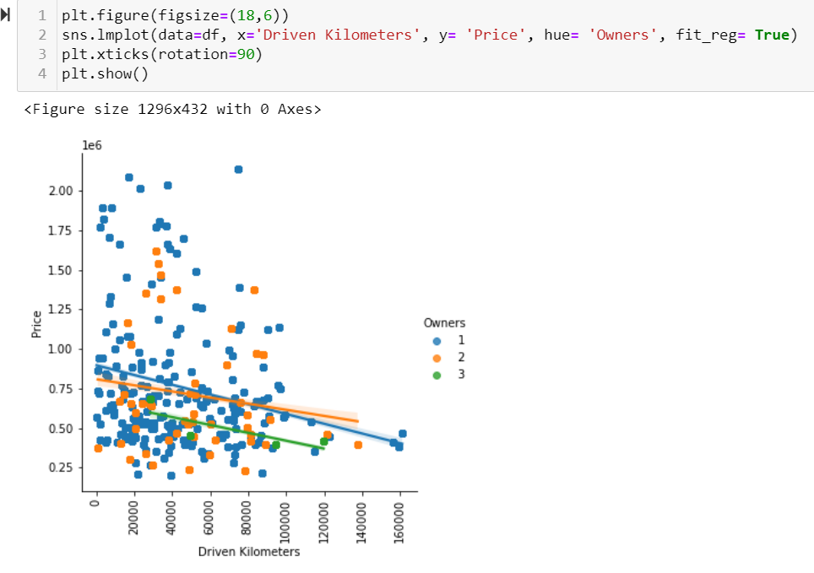
We can observe that the Price point for 3rd owner is always low. Less driven single owner cars get good sales Price.

Slide 25
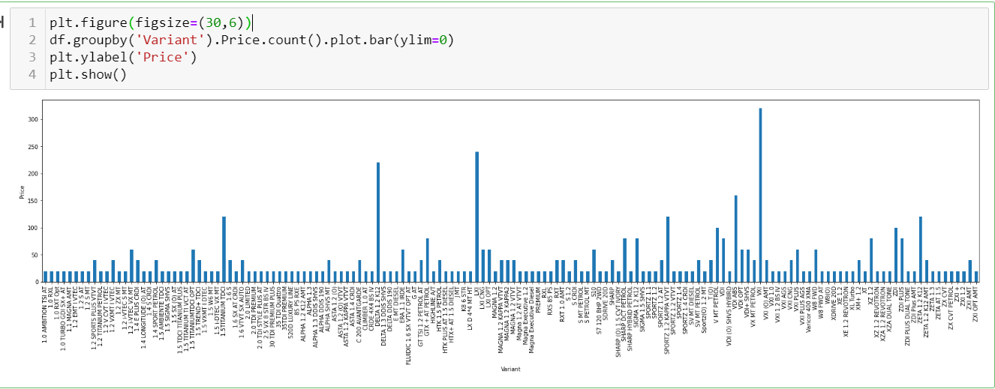
This plot helps us to get a clear view of how the car price varies with the variant of the car, for example : VXI models are higher in sales data.

Slide 26
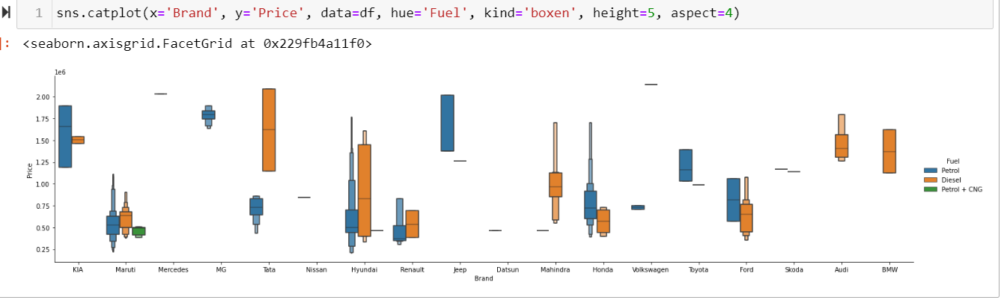
From above plot, we tried to see the mean Price value of each brand, depending on their Fuel.
For example : Mercedes and Volkswagen cars has higher means for Price.

Slide 27
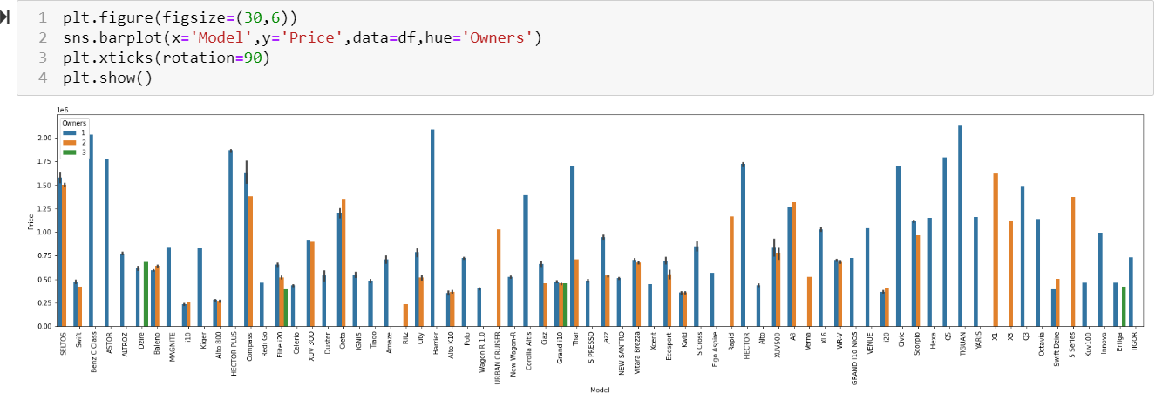
We can observe that compact cars like Dzire, Elite i20, Grand i10, Ertiga offen have 3rd owner. As these normally used for cab purpose or purchased by new driver, in order to learn driving

Slide 28
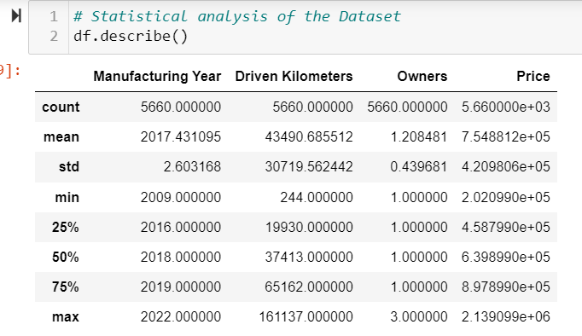
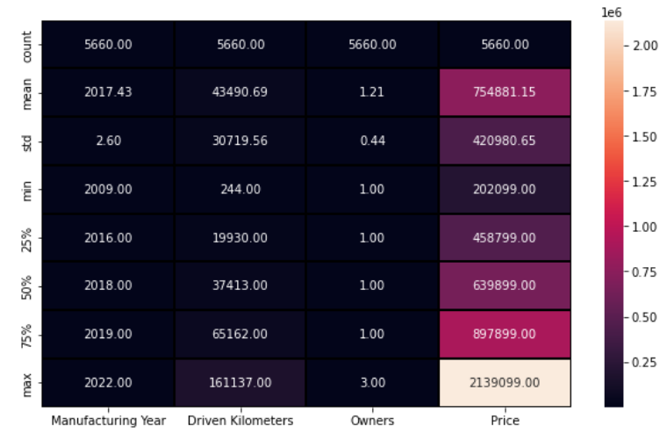
Statistical Analysis of Dataset
From above observation we can say that, the mean price of a car is around 7.5Lakh, and mean year of manufacturing is 2017 and driven kilometers is about 43490. The highest price for car in the dataset is 2139099.

Slide 29
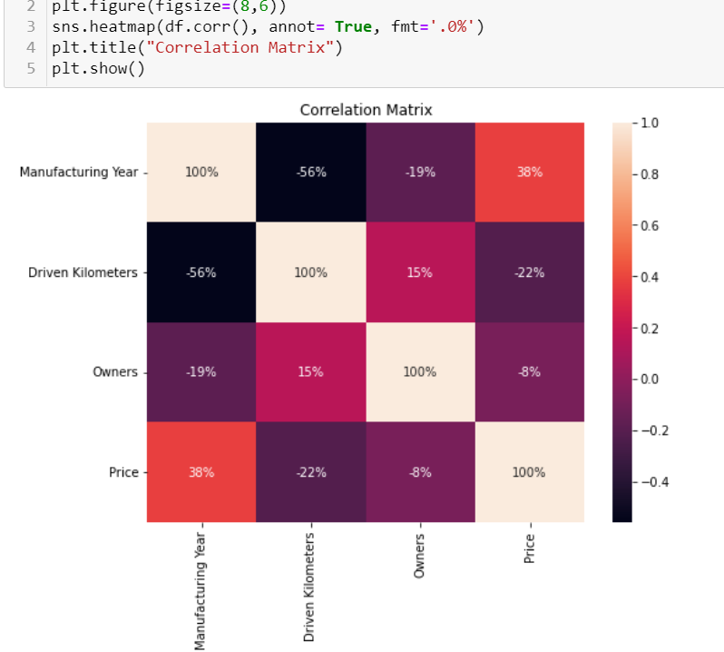
Correlation Matrix
We can observe that Manufacturing Year is highest correlated feature so far. and Owners is lesser correlation comparatively

Slide 30
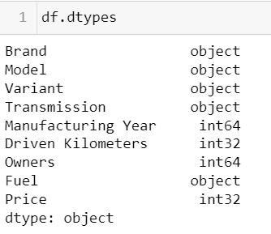
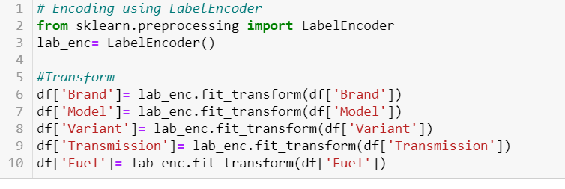
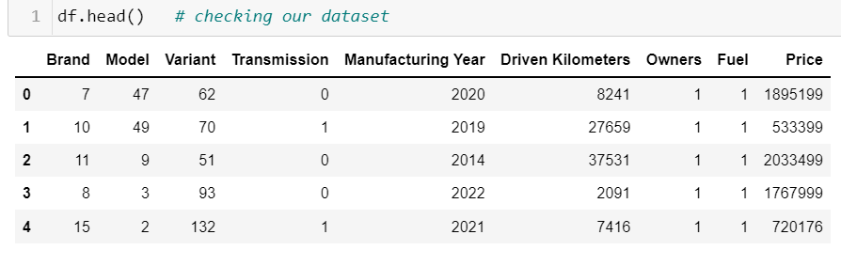
Encoding
We encode our categorical columns to numerical column using Label encoder, as all of them has nominal data, and we don’t want to increase the number of columns.

Slide 31
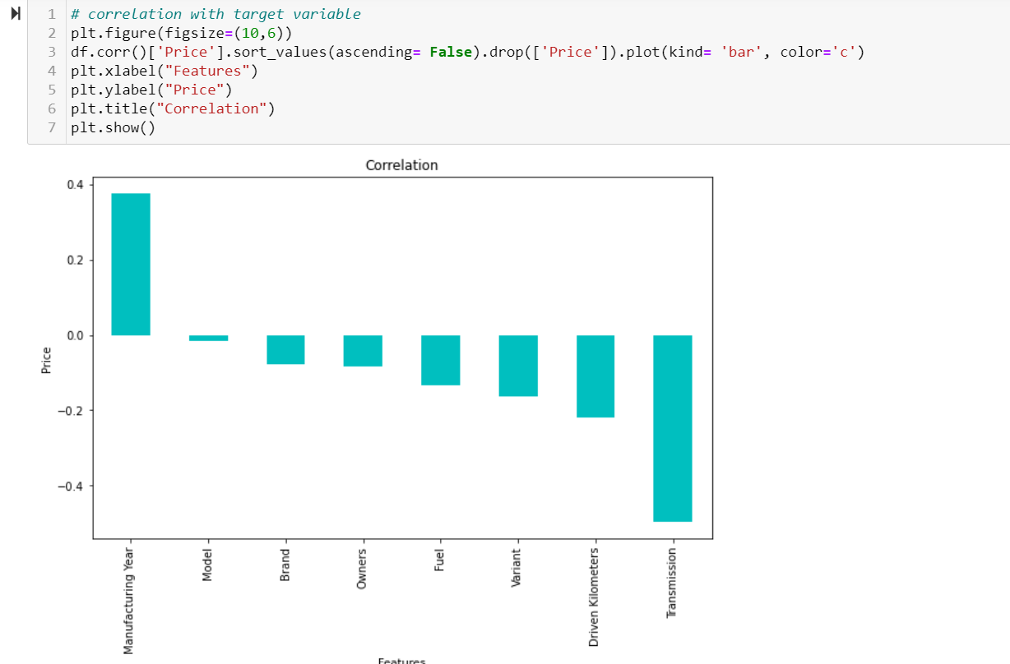
As we encode our dataset, let’s see how our features are correlated with our label.
From here We can observe that most of the features are negatively correlated with our target variable i.e Manufacturing Year shows strong correlation with Price. Model alone don't show strong correlation with Price, but we can see that Brand, Variant is comparatively stronger features.

Slide 32
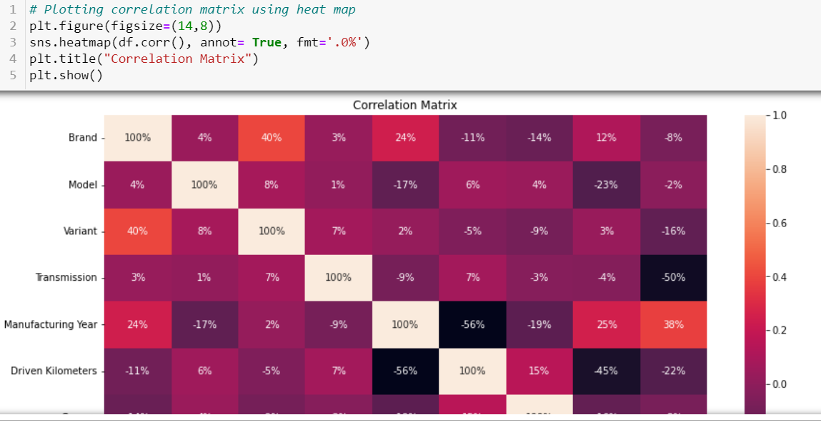
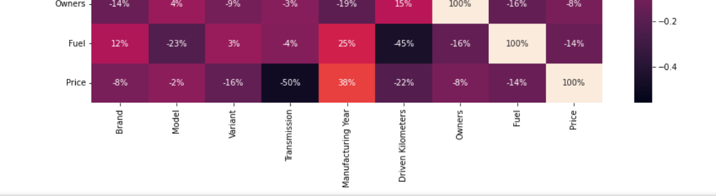
Correlation matrix with all the columns

Slide 33
Observation :
From above observation it is clear that or dataset don't have multicollinearity. As the independent variables i.e. the feature columns are not correlated with one another.
We also observe that Transmission shows strong correlation with Price. While Model shows least correlation with Price which is similar to what we observe in the previous plot.

Slide 34
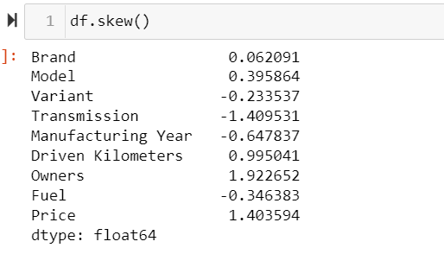
Skewness and Outliers
We use .skew() to detect skewness in the dataset.
We can observe that, taking threshold value for skewness to be =/-1 . We don't observe any strong skewness in our dataset. And those columns which shows skewness are categorical columns or label and on both the cases we don't treat skewness in them.

Slide 35
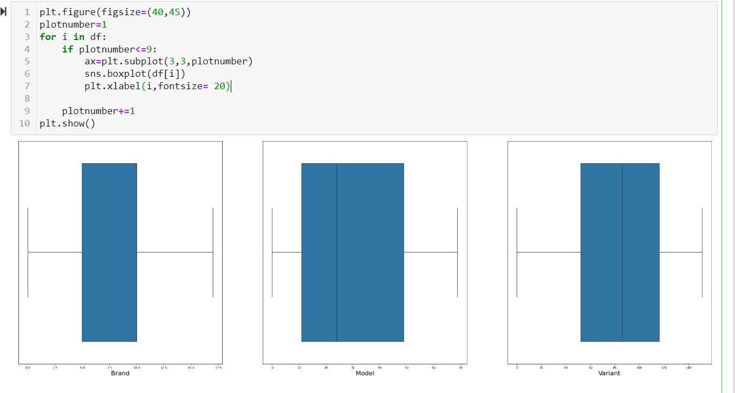
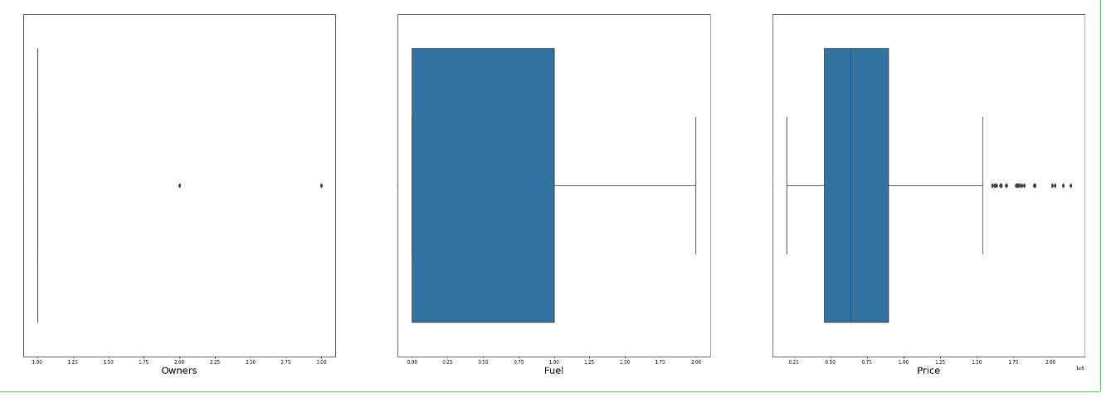
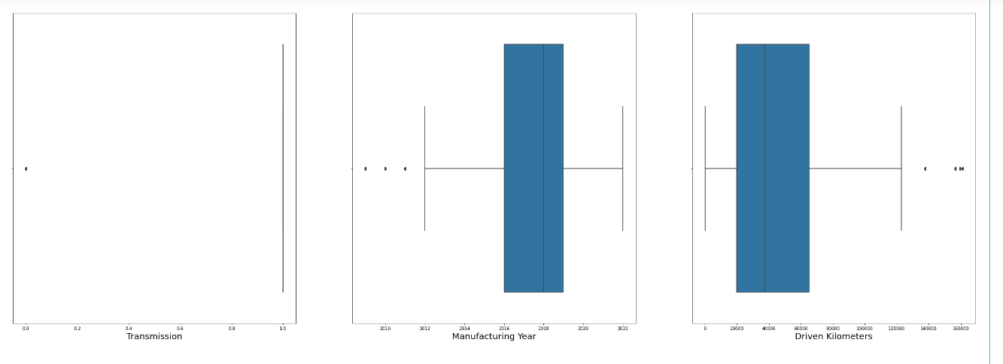
We tried to visualize the outliers using boxplot technique, and we observe that there are couple outliers in Price, but is our Label column so we don't disturb that, rest dataset looks good.
We are safe to proceed.

Slide 36
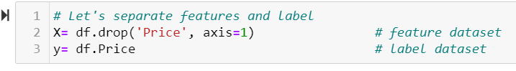
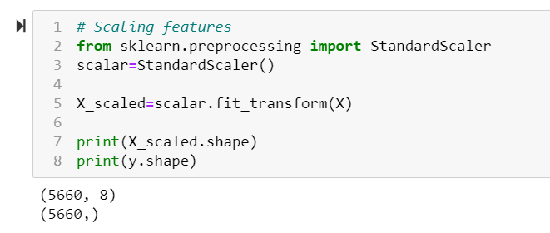
Scaling
We will use standard scalar in order to scale our data, one thing to note here that, we only scale features not label. So, we need to separate, Features and Label.
Let’s scale features using Standard Scalar

Slide 37
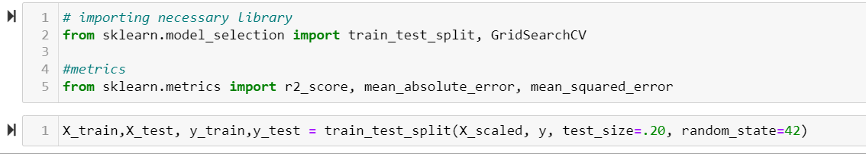
Model Building
As we are done with all our pre-processing steps, its time to build our machine learning model. For that we need to slpit our dataset into training dataset and testing dataset.
Generally the splitting is done either 80:20 ratio or 75:25 ratio of training dataset to testing dataset. Here we decide to take 20% for testing data.

Slide 38
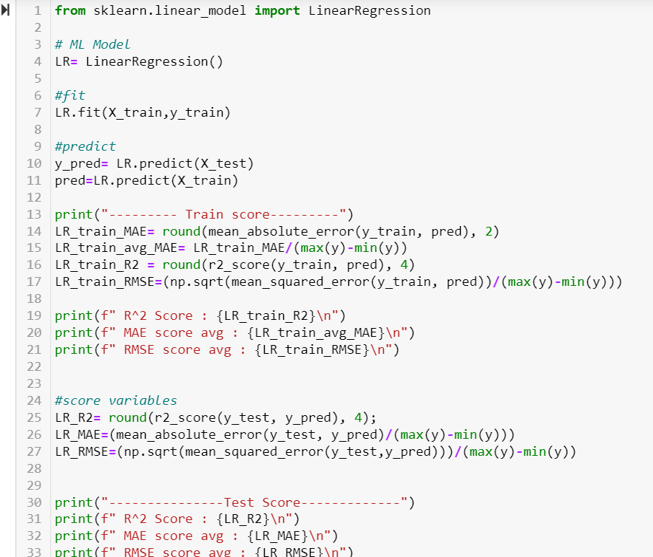
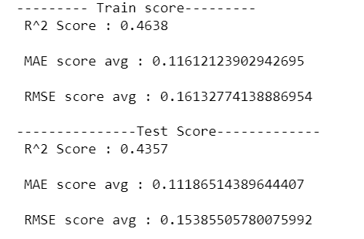

Linear Regression

Slide 39
Observations
We are using r2 score , mean absolute error and root mean squared error as our scoring parameter, It will help us to determine the efficiency of the model. And at the end helps in model selection.
Also, we are taking the calculated average values of both the errors because normally it tells us the deviation from actual value, and our actual value are in 7 figures. So, it’s better to calculated the average of all the deviations. Our motive is to have the values near to zero. Let’s have a look at our scores.
We can observe that although our MAE. RMSE scores are better, we can still work on r2 score. After cross validation the score increase slightly. We can perform LASSO or Ridge to see if our Linear model works better. However, before regularization (lasso or ridge) let’s perform an ensemble technique, and see how our model performs

Slide 40




RandomForest Regressor

Slide 41




Let’s perform some visualization.
Hyper parameter tuning:

Slide 42
Observation:
These errors represent the deviation from actual value, It means if the price is 6789345 then the got a deviation in Predicted price of +/- 398.51 for mean absolute error which is very minimal. Same goes for RMSE also. Which is still pretty good score. We can say that this might be our final model.
Before deciding, let’s build 2-3 more algorithm then will summarize every model to get the best one.
We can observe that the RandomForest Regressor is completed fitted for our dataset.

Slide 43



Lasso

Slide 44


After performing Hyper parameter tuning on the model we can see slight increase on the score, nothing major changes. We can observe that Linear model is not working well with our Dataset, while the ensemble technique works amazingly well. Let's do another ensemble boosting model before finalizing.

Slide 45



AdaBoost Regressor

Slide 46



Hyper Parameter tuning for AdaBoostRegressor.
We can see that Adaboost Regressor Model also works better with our dataset. We can now go ahead and perform XGBOOST Regressor.

Slide 47



XGBOOST Regressor

Slide 48



Hyper parameter tuning for XGBoost Regressor.

Slide 49


Visualization of Score.
We can Observe that XGBOOST Regressor model , works equally well. Whatever error we are getting is also very low, After hyper parameter tuning, those error values decreases further almost tend to zero.
Also from the graph we plot, we can clearly see that there is minor deviation from true_y and predicted_y. which is not present in randomforrest

Slide 50



RIDGE Regressor

Slide 51



Hyper parameter tuning for Ridge Regressor.
We can see that our Linear models performs not well as compared to ensemble models. Let’s summarize each model in order to get a clear picture of how the models are performing.

Slide 52

Summarization of Each Model

Slide 53
From the above table we can say that, Ensemble and Gradient Model works best with our dataset. However linear models show comparatively weaker performance. Also we can observe that Random Forest Regressor act like the perfect match for this particular dataset. One logical reason which I can think of is that, it might be possible since data is collected from only one website(car24.com) & one location(Delhi), there are chances that particular website is using RandomForest Algorithm to predict the prices of the Cars listed in there.
XGBoost Regressor works equally well with the dataset, with some errors or deviations here and there.
We can also Observe that Linear Regression and Lasso performs in the same manner, however Ridge shows some improvement in overall scores and hence we can say that it regularizes the linear regression model.
The performance of AdaBoost Regressor is pretty good, however we got two other models which performs better that it.

Slide 54
Conclusion
In this Project, we perform two tasks:
1. Data Collection: This is the very first part of our Project where we need to collect data from websites in order to perform a model which predict the Prices of Used car.
For that we scrape the data from car24.com website. Here we choose the location Delhi and did not apply any other filter in order to collect data of all kinds of used car like Hatchback, SUV, Minivan, Sedan, Coupe.
Here we collect a total number of 5660 cars data, and their important features are collected in the form 9 columns ( Brand, Model, Variant, Transmission, Manufacturing Year, Driven Kilometers, Owners, Fuel, Price). We can clearly see that Price is our Target Variable. And others are our independent variable or features.
We collected all this data in the form of Excel file.
2. Model Building: After collection of that, we use the same data to build our machine learning model. Here we perform all the required pre-processing steps to make the model suitable for Model Building algorithms.
We in total build 6 Models in order to select on the best on, and after evaluating every single model we came to conclude that our dataset works best with ensemble techniques. So the Best suited Model we decide is RandomForest Regressor, as it gives us both high prediction scores and low error.

Slide 55

Saving Of Final Model
We perform pickeling, Pickle is a generic object serialization module that can be used for serializing and deserializing objects.

Slide 56
Thank You

